Slide 1

Advances in AI project
Project title: Hope speech classification
Team members:
GAURAV KUMAR JAISWAL (E21CSEU0309)
CHIRAG SINGHAL (E21CSEU0262)
HARDIK SARASWAT(E21CSEU0318)

Slide 2
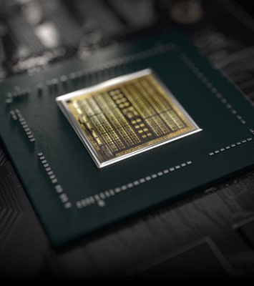
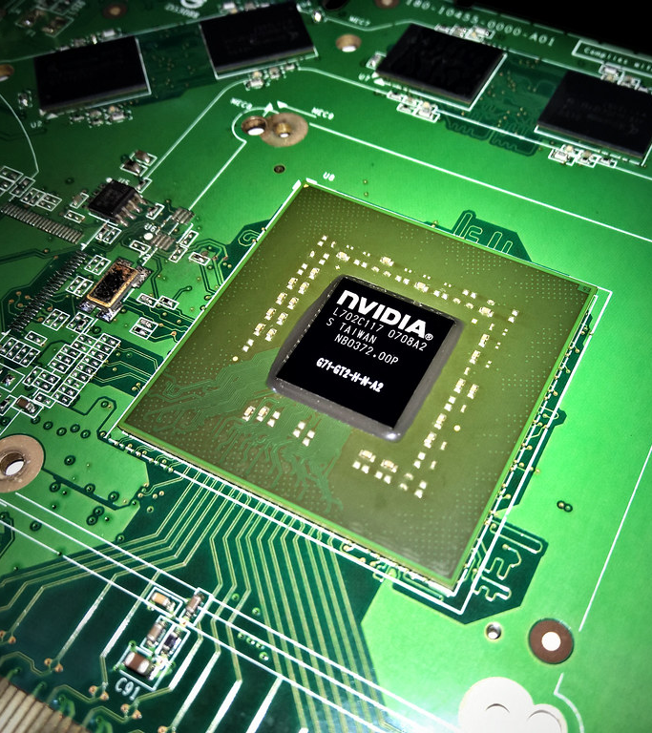
Abstract
The object is build a hope speech classification model that can read a particular text and classify whether this piece of text is hope speech or not and would give the result as a Binary result i.e whether this speech is in the category of Hope_speech or Not.
This Photo by Unknown Author is licensed under CC BY-SA
This Photo by Unknown Author is licensed under CC BY

Slide 3
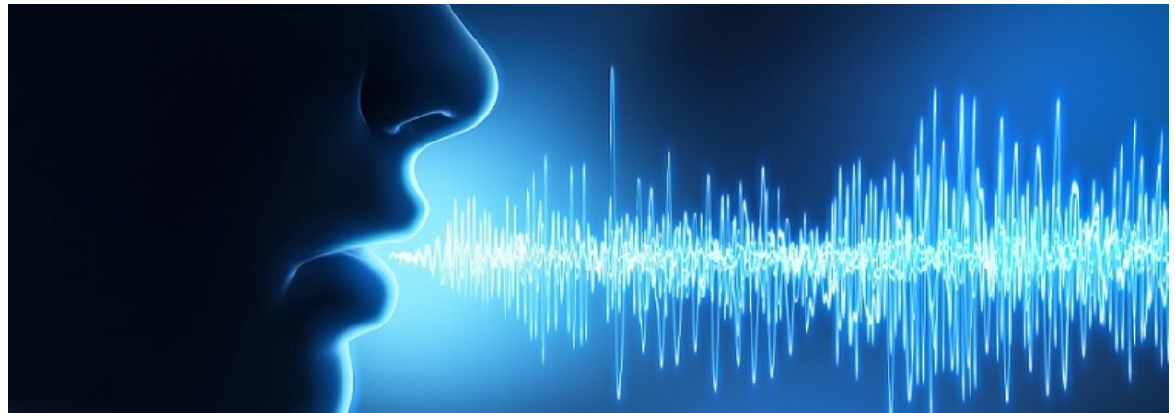

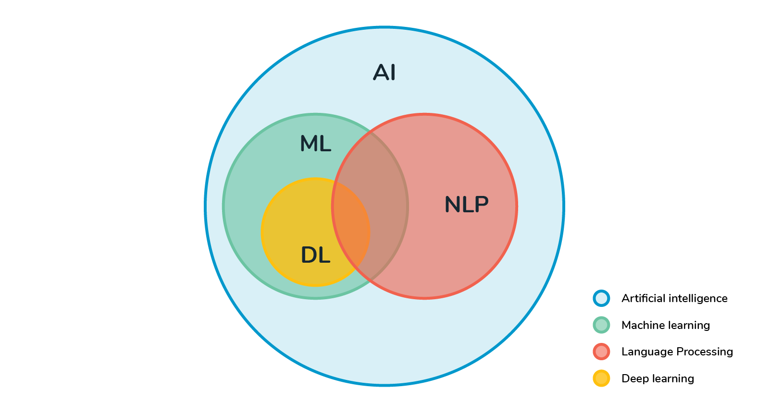
Dataset DescriptionData analysis
The dataset was sourced from 2022 LT-EDI hackathon contest where the dataset initially contains a single column where the raw text in csv format consisting of special characters and the type of speech is consisted within a single text column .
The objective was to refine the dataset and then create two columns where first column named “text” and the second column where the “type of speech” speech is contained.
The initial dataset consists of >95 percent non hope speeches while the rest are non hope speeches as per the dataset provided by the author
This Photo by Unknown Author is licensed under CC BY-SA-NC
This Photo by Unknown Author is licensed under CC BY-SA-NC
This Photo by Unknown Author is licensed under CC BY-SA

Slide 4
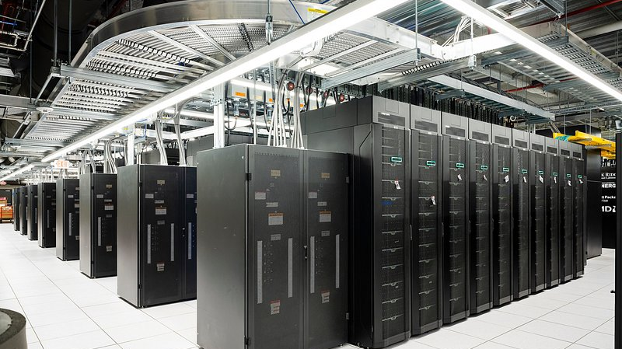
To counter this issue the data augmentation was applied so that a sufficient amount of minority classes are there so that the class imbalance might not result in data overfitting.
The exploratory data analysis before the final data augmentation is shown in the upcoming slides

Slide 5
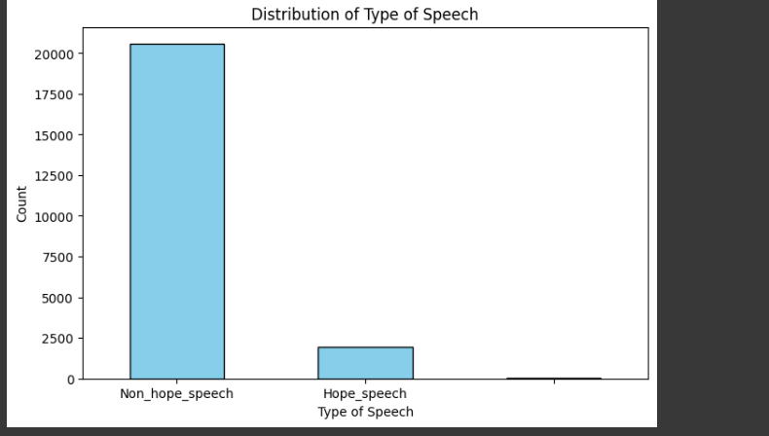
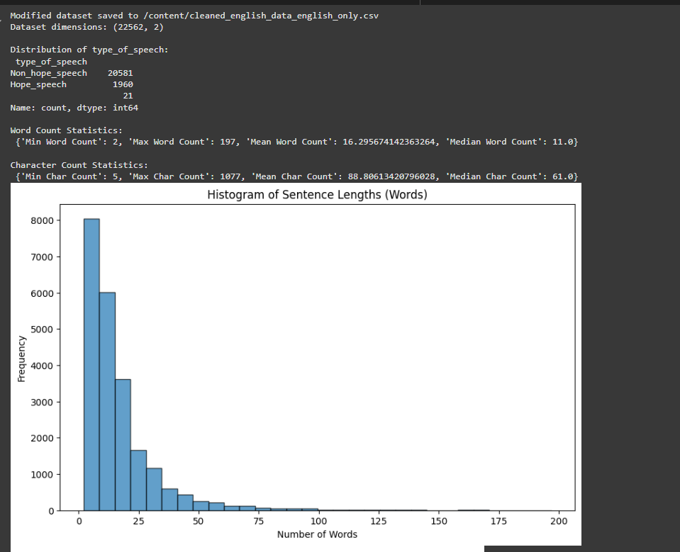
Total Number of words, by speech classification and words frequency

Slide 6


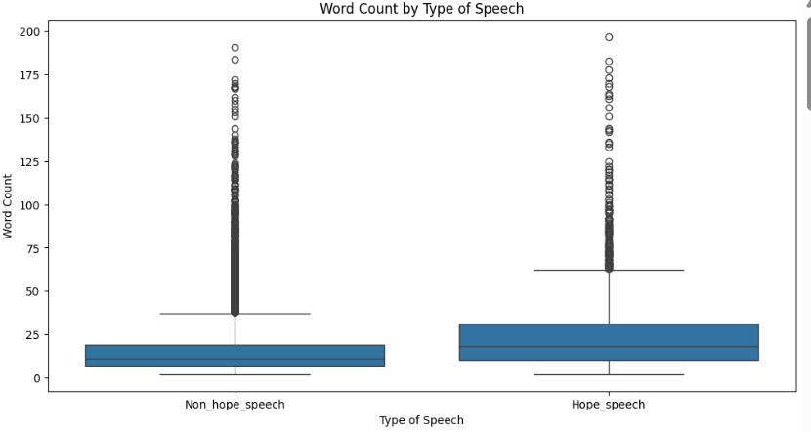
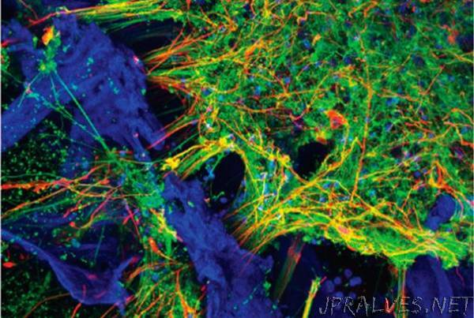
This Photo by Unknown Author is licensed under CC BY-NC-ND
This Photo by Unknown Author is licensed under CC BY-NC-ND
This Photo by Unknown Author is licensed under CC BY-NC-ND

Slide 7
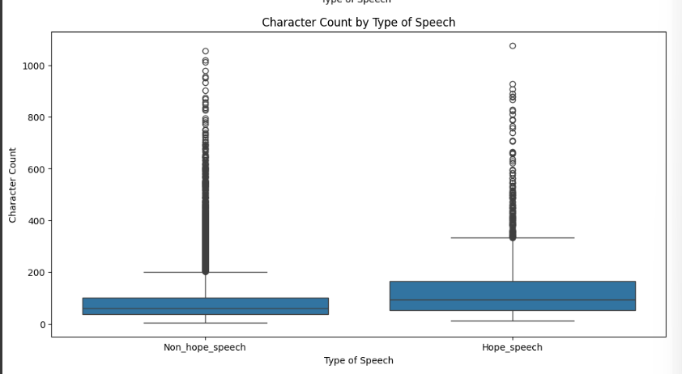

Slide 8
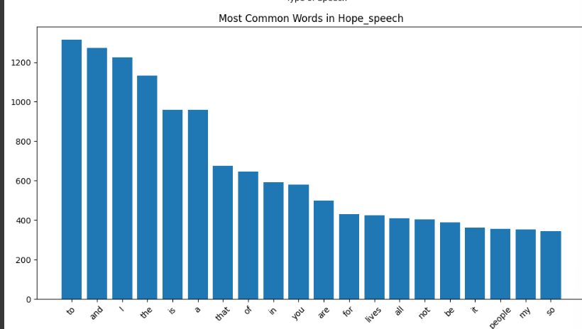

Slide 9
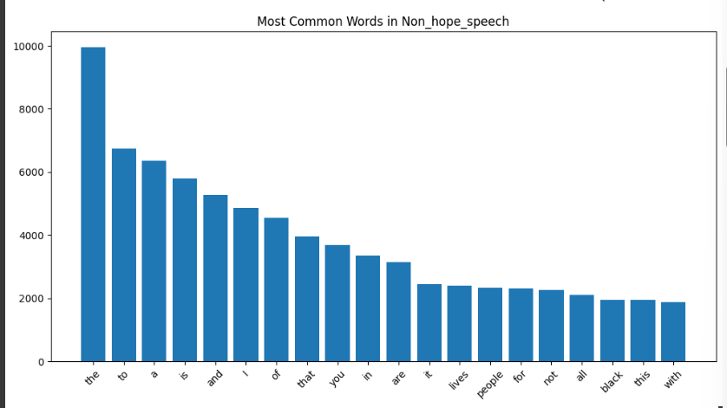

Slide 10
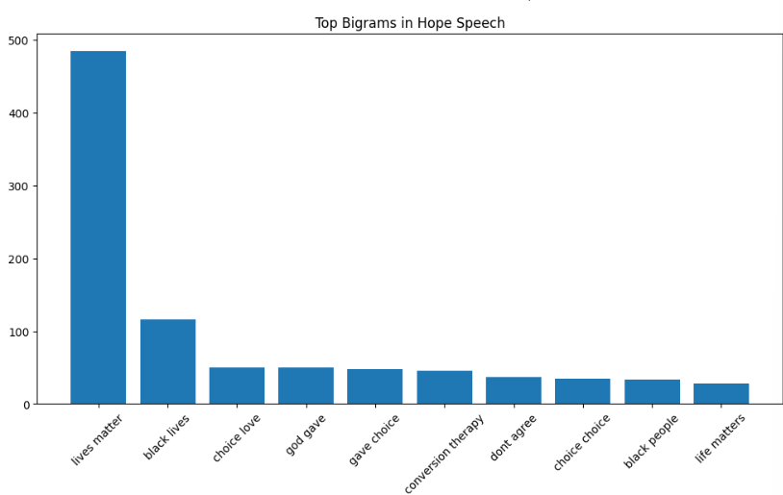

Slide 11
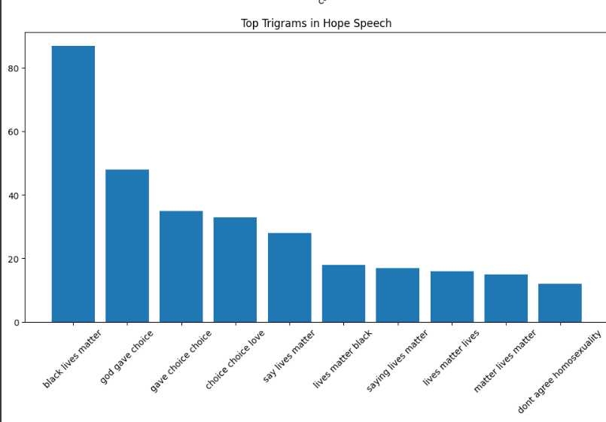

Slide 12
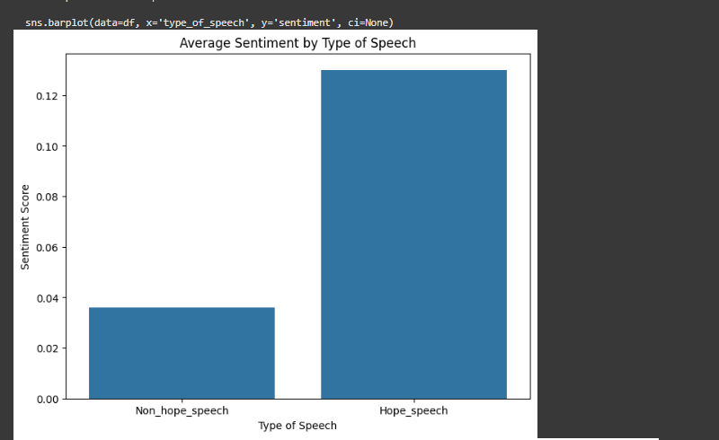

Slide 13
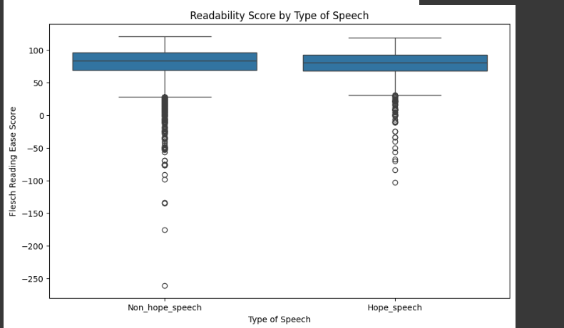

Slide 14
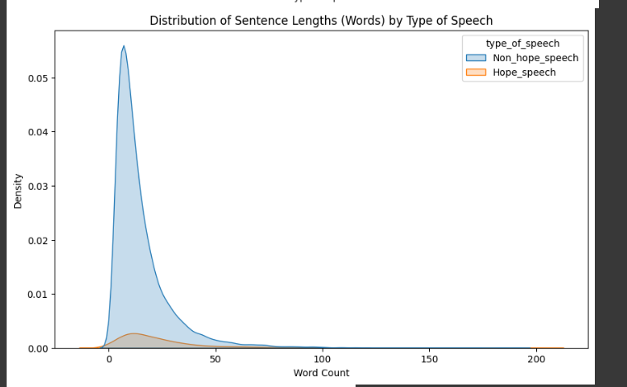

Slide 15
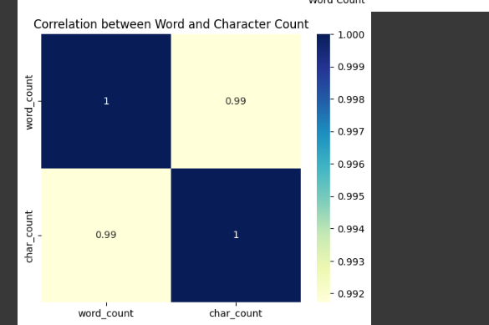

Slide 16
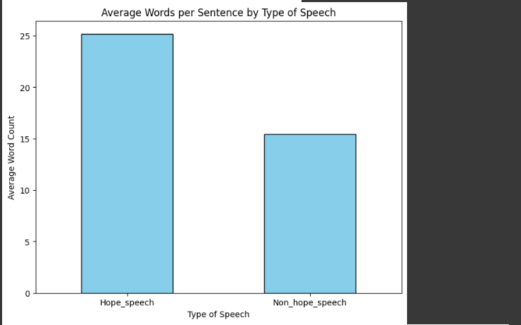

Slide 17
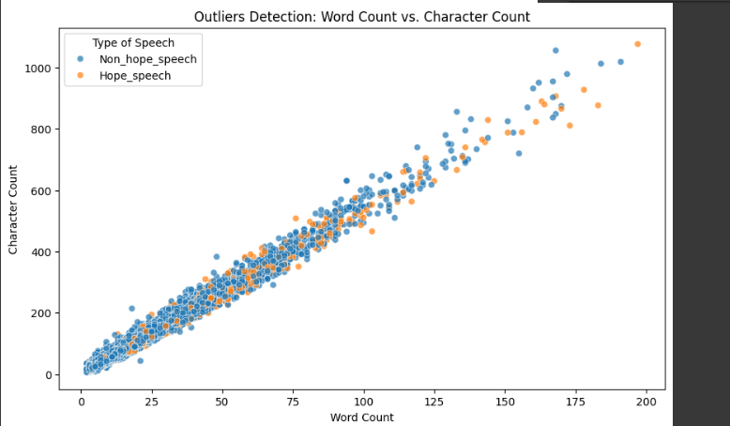

Slide 18
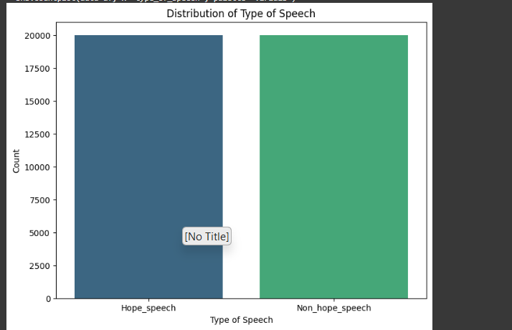
Data visualization after data augmentation

Slide 19
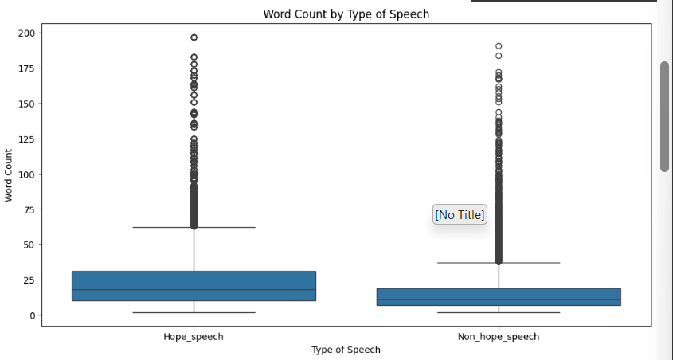

Slide 20
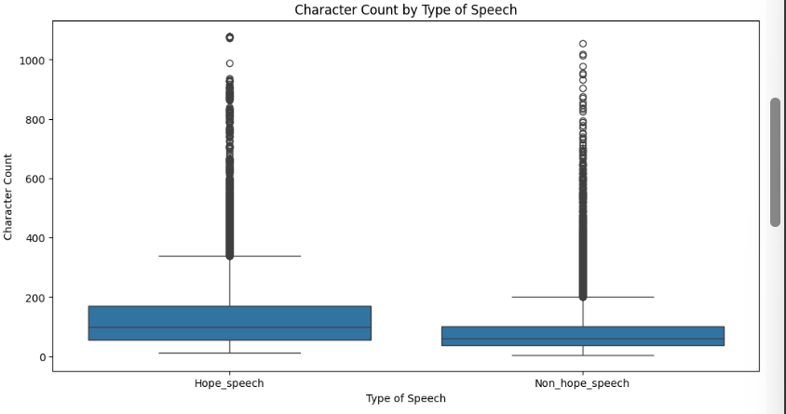

Slide 21
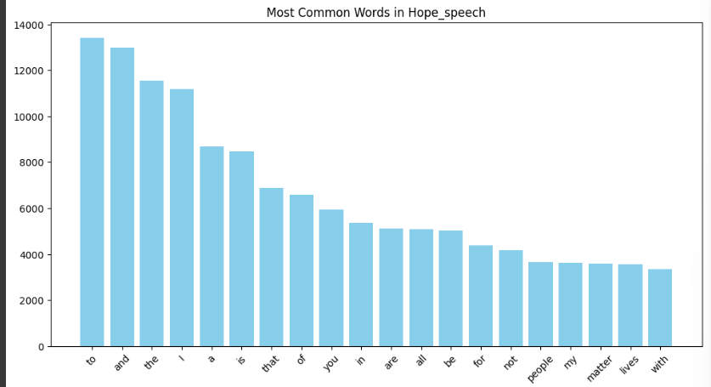

Slide 22
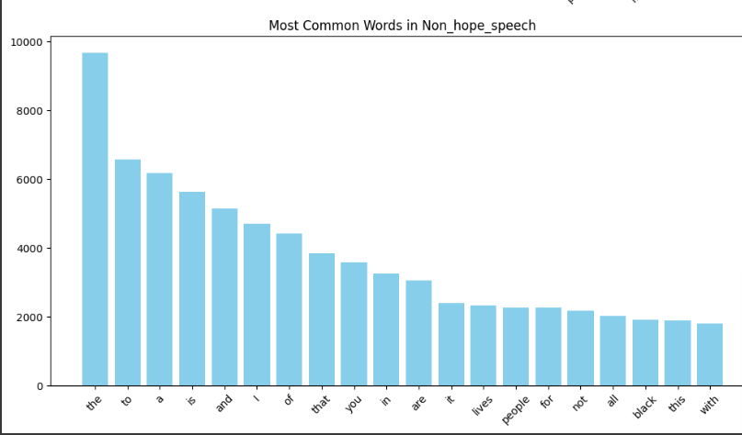

Slide 23
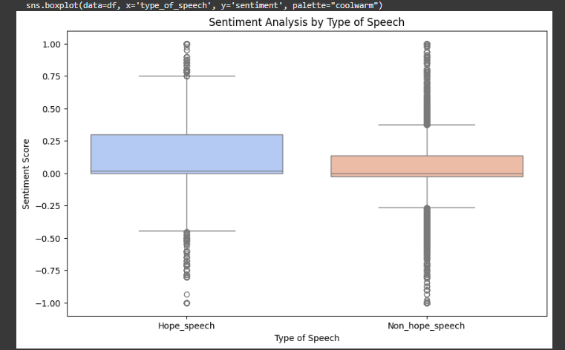

Slide 24
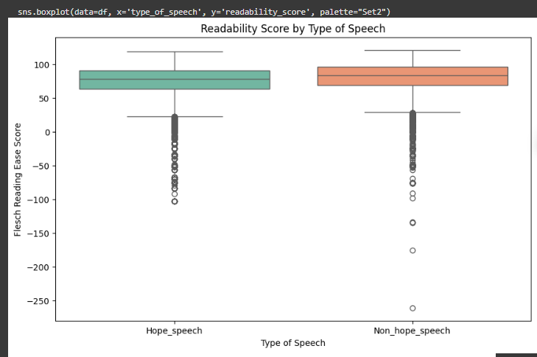

Slide 25
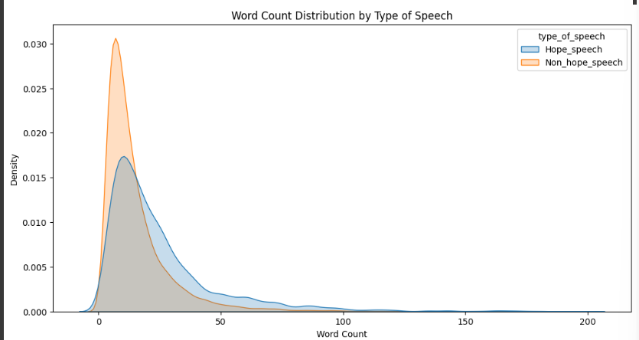

Slide 26
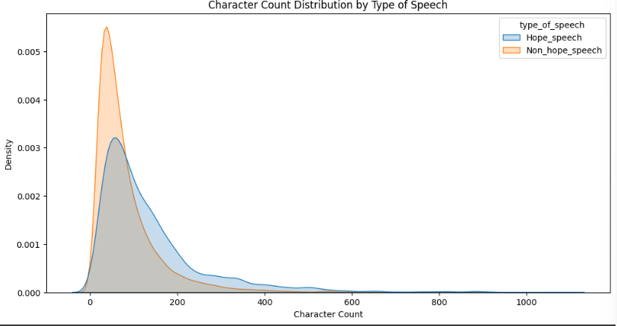

Slide 27
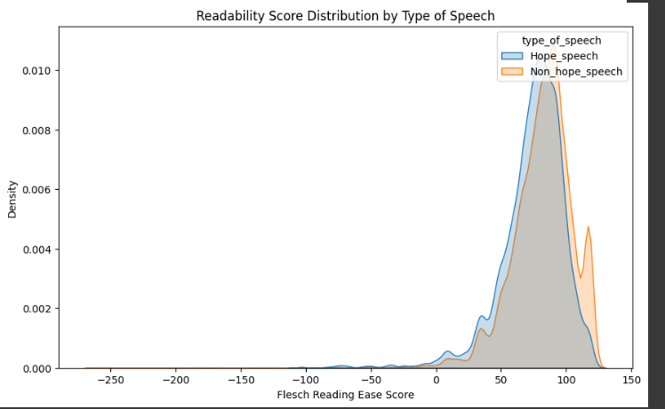

Slide 28
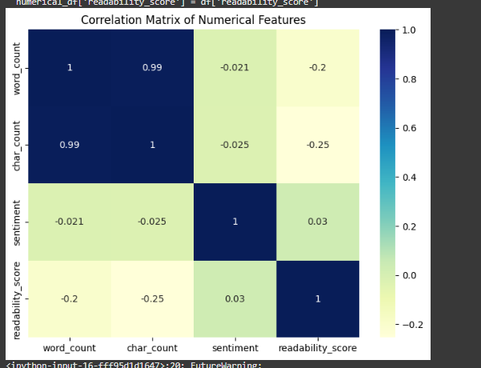

Slide 29
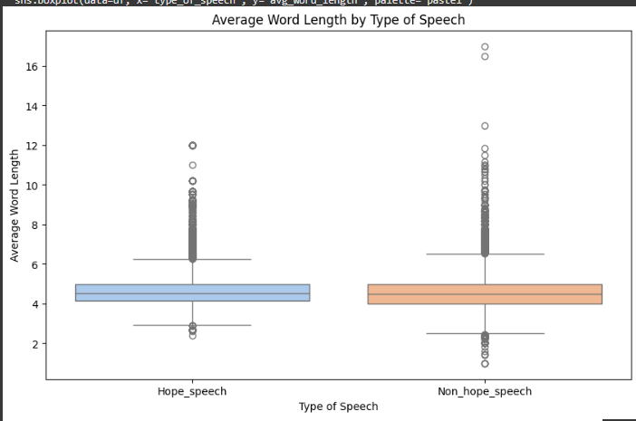

Slide 30
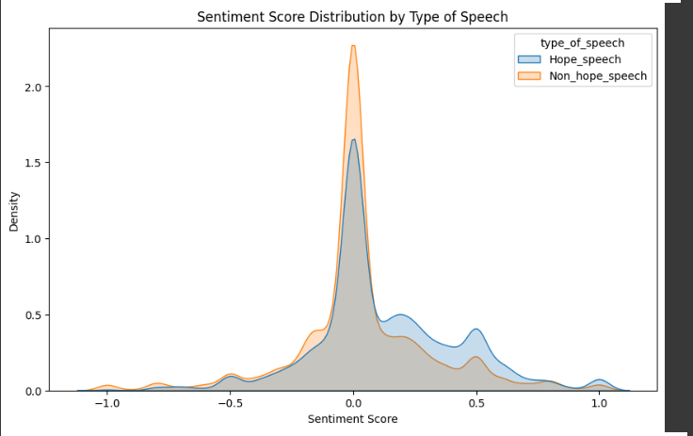

Slide 31
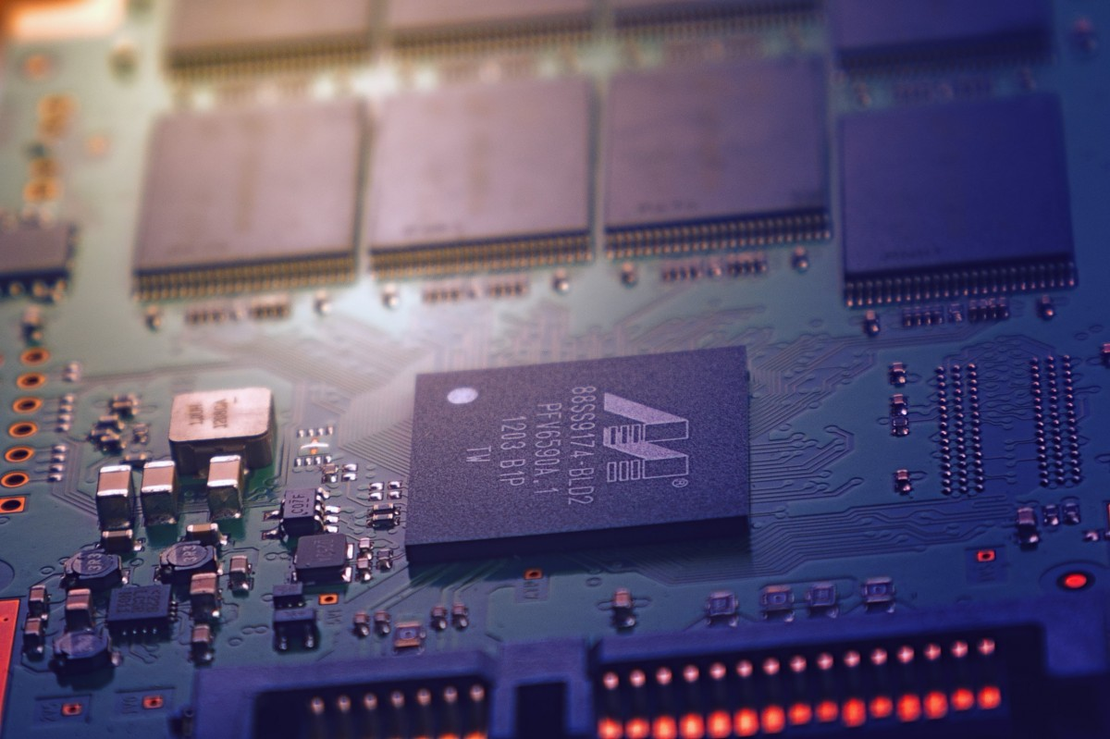
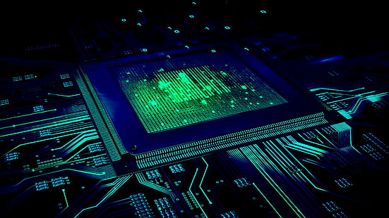
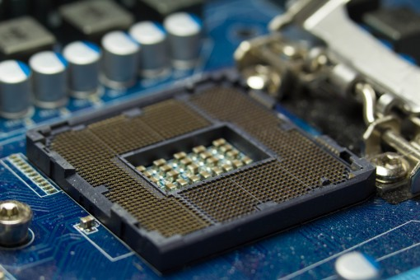
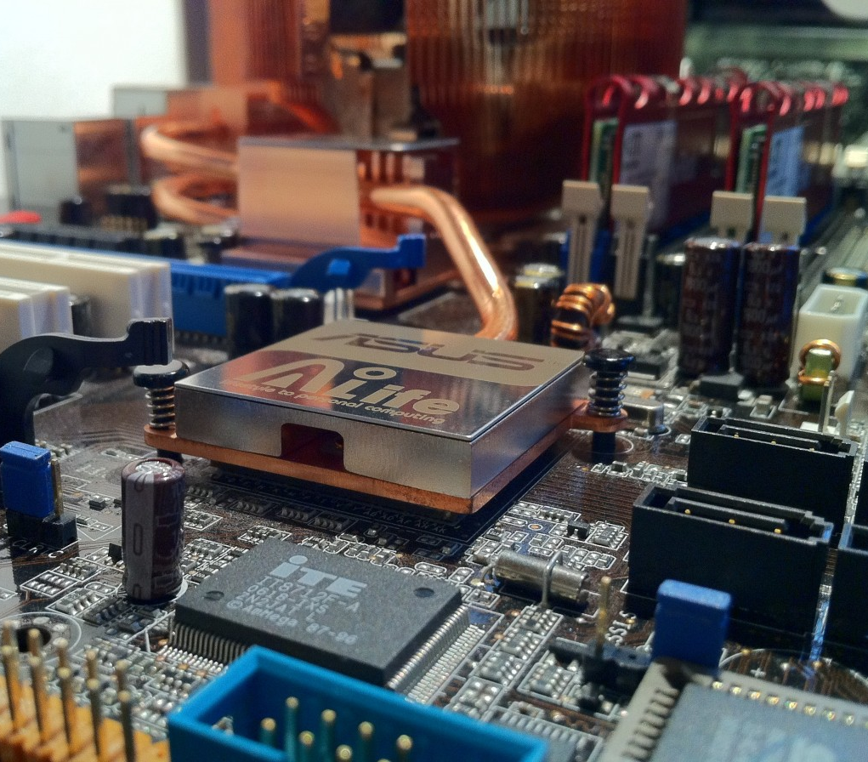
Methodologies: Glove embedding
GloVe is a pre-trained word embedding, which means it provides a fixed vector representation for each word (e.g., a 300-dimensional vector for each word).Instead of learning these representations from scratch, you use the GloVe embeddings as a starting point for your model.Each word in your text is replaced with its corresponding vector from the GloVe embeddings

Slide 32

How It Works in Models:
When using GloVe embeddings, the pre-trained vectors (like a dictionary of word meanings in numbers) are loaded into your model.
Each word in your input is mapped to its corresponding GloVe vector.
These vectors serve as the starting point for your neural network to process text, allowing the model to leverage the relationships and meanings that GloVe learned from its training data.
This Photo by Unknown Author is licensed under CC BY

Slide 33
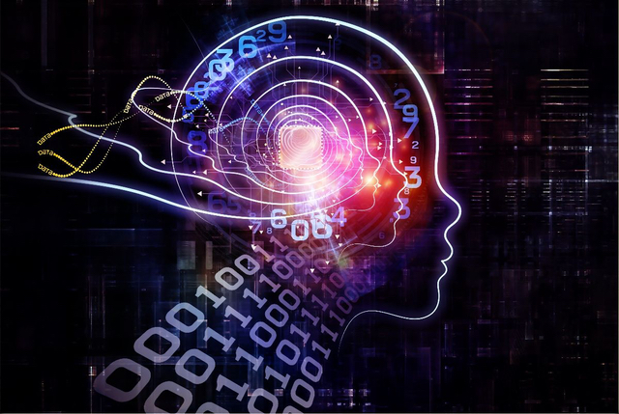
Examples
GloVe first looks at a massive dataset of text and creates a matrix that counts how often each word appears together with other words (co-occurrence). For instance:
"apple" and "fruit" might appear together frequently.
"apple" and "computer" might appear together less often but still noticeably.
This Photo by Unknown Author is licensed under CC BY-SA-NC

Slide 34


Hyper parameters for the all the models
The base models applied here are
1) Classic LSTM
2) Bidirectional LSTM
3)CNN 1D
4) RNN

Slide 35
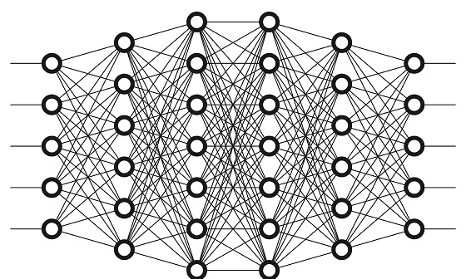
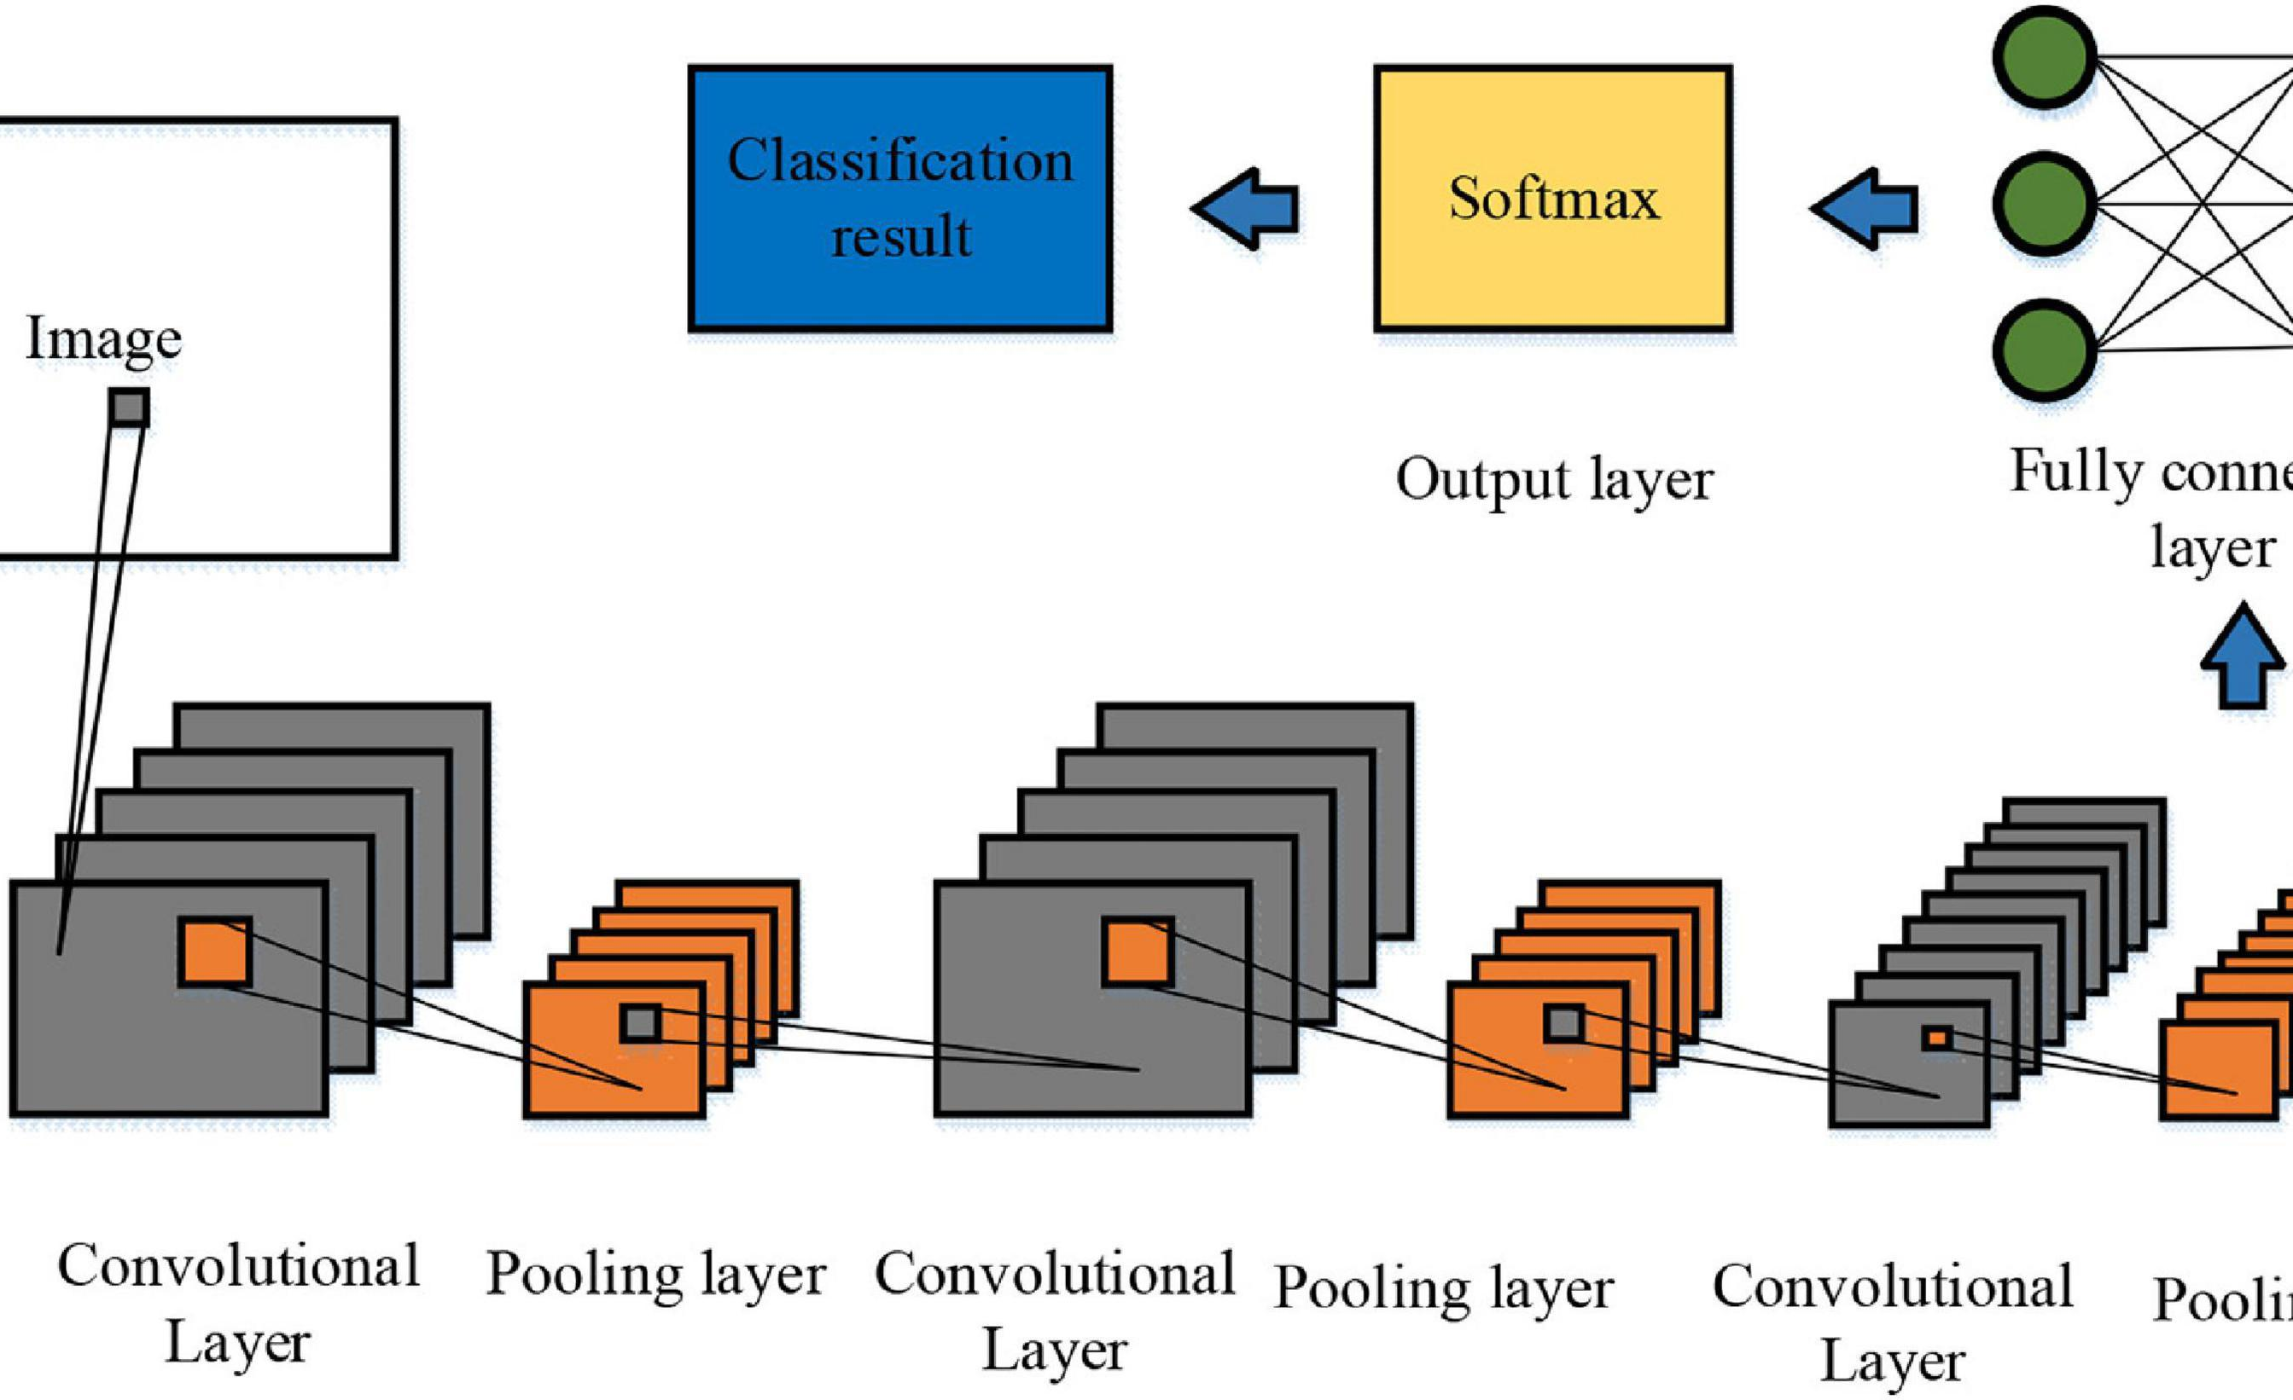
Hyper parameters and evaluation metods
All the models are tested and evaluation methiods like
1)AUC-ROC
2) precision, recall, f1 score
3)test and training accuracy
4) Weight macro and micro averages
This Photo by Unknown Author is licensed under CC BY

Slide 36

Hyper parameters
Activation function= sigmoid(for final layer)
Dropout = 0.2 units
Epochs = 100
Embedding units = 300(for glove 300d.txt)
Batch size =128
Loss Function= Binary cross entropy(for binary classification problem statemnet)
Optimizer = adam
Learning rate = 1e-4
This Photo by Unknown Author is licensed under CC BY

Slide 37

Model Results Bidirectional LSTM
This Photo by Unknown Author is licensed under CC BY-SA-NC

Slide 38
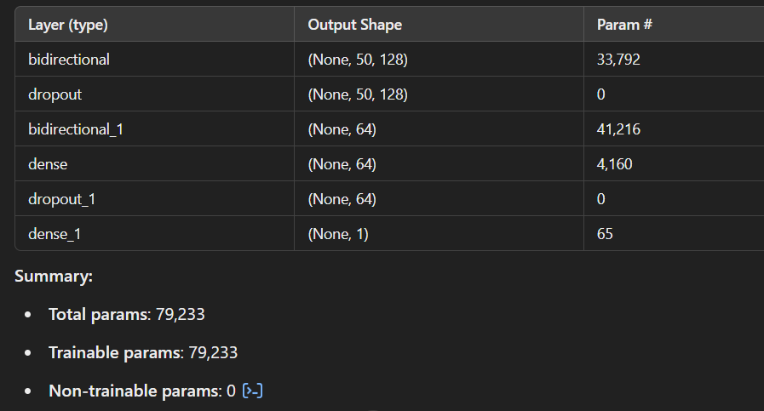
Bidirectional LSTM
Model summary:

Slide 39
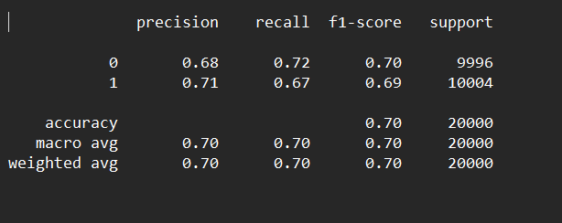
Classification report

Slide 40
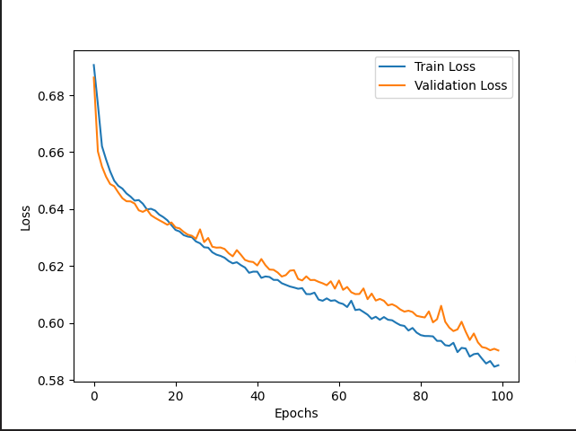
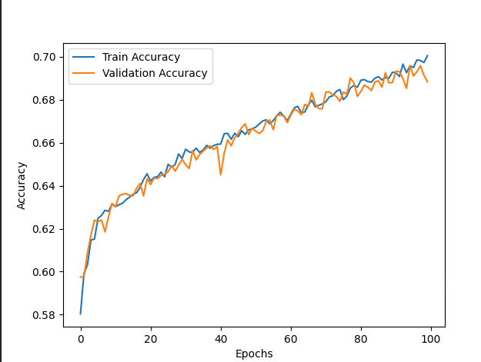
Accuracy and loss plot

Slide 41
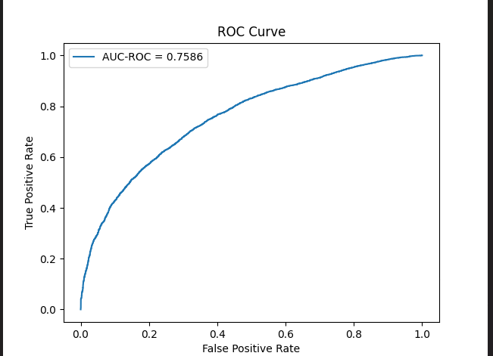
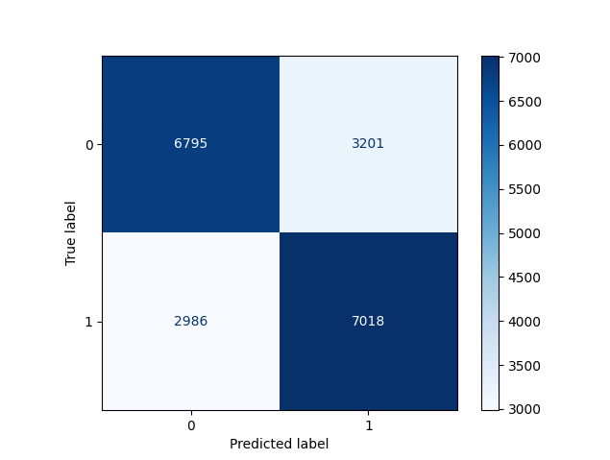
Auc –Roc curve and confusion matrix

Slide 42
el Results Bidirectional LSTM
This Photo by Unknown Author is licensed under CC BY-SA-NC
Model Results: CLASSIC LSTM

Slide 43
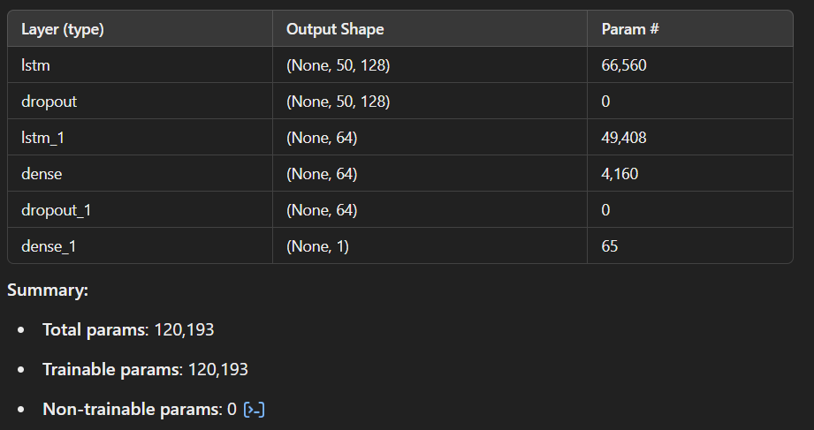
Model parameters

Slide 44
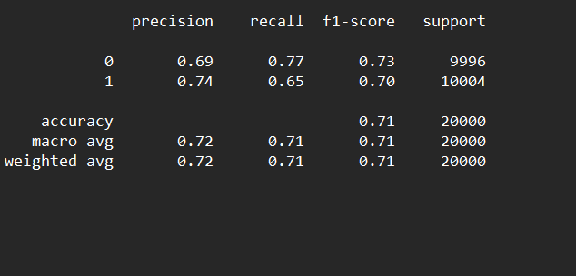
Classification report: classic lstm

Slide 45
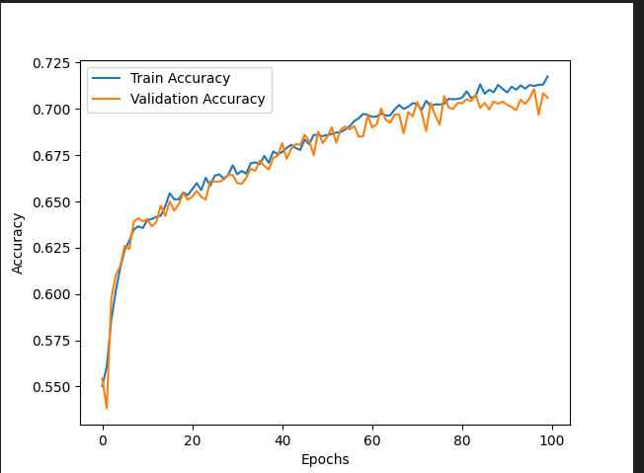
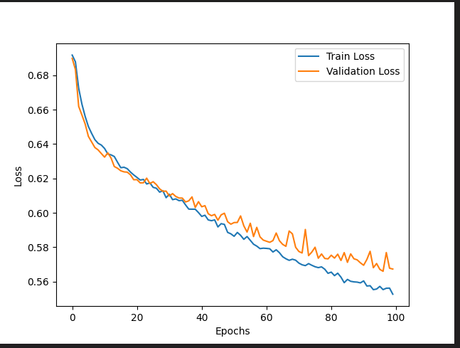
Accuracy and loss plots

Slide 46


Auc-roc curve and confusion matrix

Slide 47
sults Bidirectional LSTM
This Photo by Unknown Author is licensed under CC BY-SA-NC
Model results: simple RNN

Slide 48

Model summary: Simple RNN

Slide 49


ACCURACY AND LOSS

Slide 50

Classification Report

Slide 51


AUC-ROC AND CONFUSION MATRIX

Slide 52
sults Bidirectional LSTM
This Photo by Unknown Author is licensed under CC BY-SA-NC
Model results: 1D CNN

Slide 53

Model summary

Slide 54


AUC-ROC curve and confusion matrix

Slide 55

Classification report

Slide 56


Loss and Accuracy

